Slide 1

2011 National Household Survey (NHS):
Design and Quality
Laurent Roy
Community Data Webminar
November 21, 2013

Slide 2
Outline of the presentation
  Overview of the National Household Survey (NHS)
  Key data quality indicators

Slide 3
NHS – the context
  Statistics Canada conducted the NHS in 2011, at the same time as the Census
  It was the largest voluntary household survey ever conducted by Statistics Canada

Slide 4
NHS Collection: who did we survey?
Phase 1 of sample selection (the initial sample)
  Objective: To ensure representative results at low
  geographic levels
  A large, random sample of 4.5 million dwellings was used, corresponding to approximately one-third of all dwellings in Canada
  Canvasser in remote and northern areas (100%)
Notes:
There were a number of steps Statistics Canada took to mitigate the risk of non-response bias from collection to the processing and weighting process.
Given the voluntary nature of the survey we knew that certain groups such as recent immigrants, Aboriginal people living in urban areas, those in low income, the more mobile were more at risk of not responding to this survey.
Also the design of the survey was targetted to provide as much as possible representative results at lower geographic levels, such as at the community level (census subdivisions).
The objective of the NHS sample design: was to better control potential data bias
A Two phase approach was taken to sampling: the initial sample and sub-sample to follow up non-responding household
READ SLIDE.

Slide 5
NHS Collection: how did we reduce bias?
Phase 2 of sample selection (the sub-sample)
  Objective: To control for potential bias and, to some
  extent, sampling variation
  A random sub-sample was selected from the remaining non-responding households (as of
  July 14, 2011)
  The allocation of sub-samples varied by geography and was a function of the level of non-response and the degree of population homogeneity.

Slide 6
NHS Design overview
Canada Population = U
Initial non-respondents
Initial respondents
Sub-sample for follow-ups

Slide 7
NHS Collection: how did we do?
  Response rate for the NHS at the Canada level
  68.6% for occupied private dwellings (unweighted) and 77.2% (weighted)
  44.7% completed the questionnaire on-line

Slide 8
NHS collection response rate by province and territory, showing the unweighted and weighted rate
Province and territory | Unweighted Response rate (%) | Weighted Response rate (%)
Canada Newfoundland & Labrador | 68.6 63.3 | 77.2 72.5
Prince Edward Island Nova Scotia | 60.4 65.0 | 70.0 74.8
New Brunswick Quebec | 63.9 71.9 | 74.2 80.7
Ontario Manitoba | 67.6 69.1 | 76.3 76.3
Saskatchewan Alberta | 63.8 67.3 | 73.1 75.4
British Columbia Yukon | 69.5 64.9 | 77.1 72.7
Northwest Territories Nunavut | 83.9 76.3 | 83.8 76.3

Slide 9
NHS collection response rate by census subdivision, showing the population size

Slide 10
NHS Collection: the results
  Within provinces and territories: Response was good in all large urban population centres; varied by the size of municipalities (census subdivisions)
  For returned questionnaires:
    Completeness of responses to questions related to respondents’ demographic, socio-cultural, language, mobility and education characteristics are comparable to the 2006 Census long-form responses
    Non-response was higher than in 2006 for the remainder
    (the last part of the questionnaire)

Slide 11
Response quality indicator: imputation rate for NHS estimates
The imputation rate is the proportion of respondents who did not answer a given question or whose response is deemed invalid and for which a value was imputed
NHS Question | Imputation rates % |  | NHS Question | Imputation rates % |  | NHS Question | Imputation Rates %
#09 - Place of birth | 2.0 |  | #30 - University certificate, diploma or degree | 4.7 |  | #49 - Language of work | 12.9
#10 - Citizenship | 2.3 |  | #31 - Major field of study | 14.2 |  | #50 - Weeks worked in 2010 | 15.1
#11 - Landed immigrant status | 1.3 |  | #32 - Location of study | 12.1 |  | #51 - Full-time or part-time work | 14.6
#12 - Year of immigration | 12.5 |  | #33 - Attendance at school | 6.1 |  | #E1 - Household maintainer | 11.8
#13 - Knowledge of official languages | 0.7 |  | #34 - Hours Worked | 6.7 |  | #E2 - Tenure | 10.7
#15 - Home Language | 0.6 |  | #35 - On lay off or absent | 10.5 |  | #E3 - Condominium Status | 9.4
#16 - Mother Tongue | 0.6 |  | #36 - New job to start | 8.0 |  | #E4A - Rooms | 12.8
#17 - Ethnic origin | 5.8 |  | #37 - Look for work | 7.8 |  | #E4B - Bedrooms | 11.4
#18 - Aboriginal group | 3.7 |  | #38 - Reason unavailable for work | 10.3 |  | #E5 - Period of construction | 13.5
#19 - Population group | 3.9 |  | #39 - When last worked | 8.7 |  | #E6 - Condition of dwelling | 10.7
#20 - Registered or Treaty Indian status | 4.7 |  | #40 - Industry | 13.6 |  | #E8A - Electricity payment | 19.5
#21 - Membership in a First Nation or Indian Band | 3.8 |  | #41 - Place of work status | 11.3 |  | #E8B - Fuel payment | 19.0
#22 - Religion | 4.4 |  | #42 - Occupation | 13.6 |  | #E8C - Water, other service payment | 19.5
#23 - Mobility 1 year ago | 4.8 |  | #44 - Class of Worker | 12.2 |  | #E9A - Rent | 14.3
#24 - Mobility 5 years ago | 6.9 |  | #45 - Incorporation status | 8.1 |  | #E9B - Subsidy status | 13.9
#25A - Place of birth – Father | 6.0 |  | #46 - Place of work location | 13.0 |  | #E10A - Mortgage payment | 18.0
#25B - Place of mother - Mother | 5.7 |  | #47A - Mode of Transportation | 12.1 |  | #E10B - Property taxes included in mortgage | 17.2
#27 - Secondary School diploma or equivalent | 4.6 |  | #47B - Vehicle occupancy | 13.7 |  | #E10C - Property taxes | 20.8
#28 - Registered Apprenticeship or other trades certificate or diploma | 5.5 |  | #48A - Time leaving | 15.5 |  | #E10D - Value of dwelling | 21.2
#29 - College, CEGEP or other non-university certificate or diploma | 5.5 |  | #48B - Duration of trip | 14.8 |  | #E10E - Condominium fee | 22.8

Slide 12
Evaluation of the quality of NHS estimates
  Evaluation of quality involved comparisons with data from previous censuses, and other sources:
    Comparisons were done mainly at higher levels of geography: Canada, provinces and territories
  For validation purposes, the NHS was linked to other data sources, for example to identify areas of potential non-response bias:
    To the 2011 and 2006 Censuses
    To some administrative files , e.g. Longitudinal Immigration Database

Slide 13
Data quality: overview of potential survey errors
  Sampling error: related to the population size; the number of survey respondents; the variability of the variables being measured
  Non-sampling error: arising from bias due to non-response (question or household level), response errors, coding errors, frame errors and processing errors

Slide 14
Indicator of the quality of NHS estimates: Global non-response (GNR)
    GNR combines complete non-response (household) and partial non-response (question) into a single rate. It is calculated for different geographic areas
  Why is the GNR used as indicator of quality?
    Similar approach as used for past long–form censuses
      Assumption: Non-response level is correlated with non-response bias; hence, the GNR provides an indicator of potential non-response bias
      A smaller GNR indicates a lower risk of non-response bias and, as a result, lower risk of inaccuracy
  NHS estimates are released for areas with a GNR of less than 50%
  Coefficient of variation is available to users to indicate estimates’ variability

Slide 15
Global non-response rate (GNR) by province and territory

Slide 16
Dissemination of the NHS estimates
Relative to 2006, there is a reduced level of data released for smaller geographic areas:
NHS estimates were released for 3,439 Census
Subdivisions (e.g., municipalities), down by about 1,100 CSDs from 2006
Proportionally, this represents 75% of all CSDs in
2011 (97% in 2006)
NHS estimates were released for 97% of the total
population (99.8% in 2006)

Slide 17
Proportion of provincial/territorial population in CSDs for which NHS estimates are available (vs. 2006 Census)
Notes:
Slide shows proportion of provincial and territorial population in CSDS for which NHS estimates will be available (blue is NHS, red is 2006 Census).
In 2011, the proportion of population in the released CSDs is expected to vary as well:
from 79% in PEI 82% in Saskatchewan and 84% in the Yukon (the lowest)
to 97% in British Columbia, 98% in Quebec, and 100% in Northwest Territories (the highest)
In 2006, the lowest proportion was in Saskatchewan and British Columbia = 99.5%
We also know that rural areas affected – so will release for 85% of the population living in rural CSDs; 99% in non-rural
This varies by province and territory with Saskatchewan and Yukon having the lowest proportions: NHS estimates released for 57% of the population living in rural CSDs in Saskatchewan (95% of the population living in non-rural CSDs.

Slide 18
Comparability to 2011 Census counts: an indicator of NHS estimates’ quality
For the same target population, a discrepancy vs. 2011 Census counts is an indication of the quality of the NHS estimates
Calibration was used as a method to reduce (or eliminate) differences between the 2011 Census counts and the NHS estimates for common topics
Final weight adjustment based on calibrated areas (some made up of several small municipalities) may lead to discrepancies between the NHS estimates and the census counts for small municipalities

Slide 19
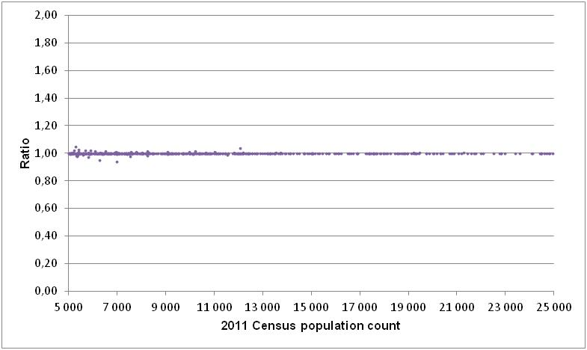
2011 Census population counts vs. 2011 NHS estimates
The ratio of the NHS population estimate to the 2011 Census population count, census subdivisions (CSDs) with a population of 5,000 to 24,999

Slide 20
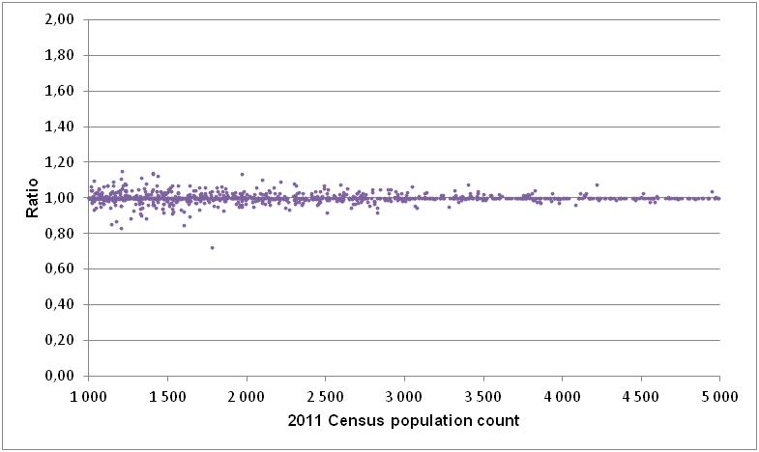
2011 Census population counts vs. 2011 NHS estimates (continued)
The ratio of the NHS population estimate to the 2011 Census population count, census subdivisions (CSDs) with a population of 1,000 to 4,999

Slide 21
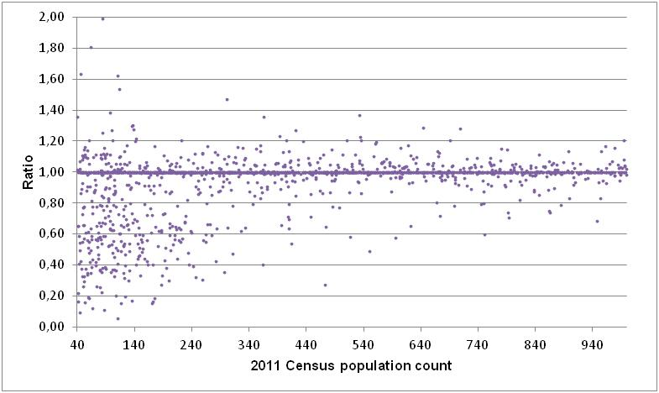
2011 Census population counts vs. 2011 NHS estimates (continued)
The ratio of the NHS population estimate to the 2011 Census population count, census subdivisions (CSDs) with a population of 40 to 999

Slide 22
Are NHS estimates affected by non-response bias?
  Non-response bias is a potential source of error for all surveys, including the NHS.
    It increases as the response rate declines.
    It arises when the characteristics of those who choose to participate in a survey are different than those who refuse.
  It is impossible to definitively determine how much the NHS may be affected by non-response bias. However, based on information from other data sources, evidence of non-response bias does exist for certain populations and for certain geographic areas.
  Generally, the risk of error increases for lower levels of geography and for smaller populations.

Slide 23
Examples of possible non-response bias
Aboriginal: Estimates and trends from other data sources suggest that the Inuit population living outside of Inuit Nunangat is overestimated at the national level.
Ethnic origin: The population born in the Philippines is overestimated at the national level (comparisons to administrative data from Citizenship and Immigration Canada).
Education: Comparisons with other data sources suggest that the category 'university certificate or diploma below bachelor level' was over-reported in the NHS.
Income: Low-income estimates from the 2011 NHS compared to previous censuses show markedly different trends than those derived from other surveys and administrative data such as the Survey of Labour and Income Dynamics or the T1 Family File.

Slide 24
Examples of possible non-response bias (continue)
Mobility: The estimation of internal migrants from the 2011 National Household Survey are, in general, lower than the ones derived from administrative data.
Language: Evidence suggests that the population who reported having Malayo-Polynesian languages as their mother tongue is overestimated at the national level. The population reported having Romance languages as their mother tongue appears to be underestimated.
Housing: Comparison of the homeownership rate in Alberta to that from the 2010 Survey of Labour Income Dynamics (SLID) showed the NHS rate was higher with a statistical significance. The national rate and the rate for other provinces were not statistically different.
HOWEVER, the numerous data evaluations conducted support the general reliability of the data at the national, provincial and territorial levels.

Slide 25
Coefficient of variation for measuring the sampling error
  The CV is a measure used to describe the precision of an estimate, i.e. it is a measure of the sampling error.
  Sampling error was also present for estimates based the 2006 mandatory Census long-form (i.e. based on 1 in 5 sample)
  A Note on CVs was released in early October 2013 (see Reference products):
    http://www12.statcan.gc.ca/nhs-enm/2011/ref/cv/cvnote.cfm?Lang=E
  Larger CVs can be observed for smaller geographic areas like census subdivisions (CSDs) and territories or rarer characteristics like visible minority, immigrants or unemployed.
Notes:
The CV does not measure bias, such as the bias due to non-response. It is important not to confuse the CV with the response rate and the global non-response rate for the NHS. The CV measures the precision of an estimate, while the response rate is an indicator of the risk associated with household non-response error, and the global non-response rate is an indicator of the risk of household non-response error plus individual question non-response error.

Slide 26
Comparability to the 2006 Census long form
Two different target populations: the 2006 Census long form includes usual residents in collective dwellings and persons living overseas whereas the NHS excludes them
Two different methodologies: the NHS estimates are derived from a voluntary survey and are therefore subject to potentially higher non-response error than those collected in the 2006 Census long form.

Slide 27
Information on Data Quality
  A data quality indicator (GNR) is provided with each geographic area published
National Household Survey User Guide
Reference Guides for each NHS topic
(e.g. Ethnic Origin)
Standard notes about quality attached to products

Slide 28
Thank you!
For more information, please contact:
Pour plus d’information, veuillez contacter:
laurent.roy@statcan.gc.ca

