Slide 1
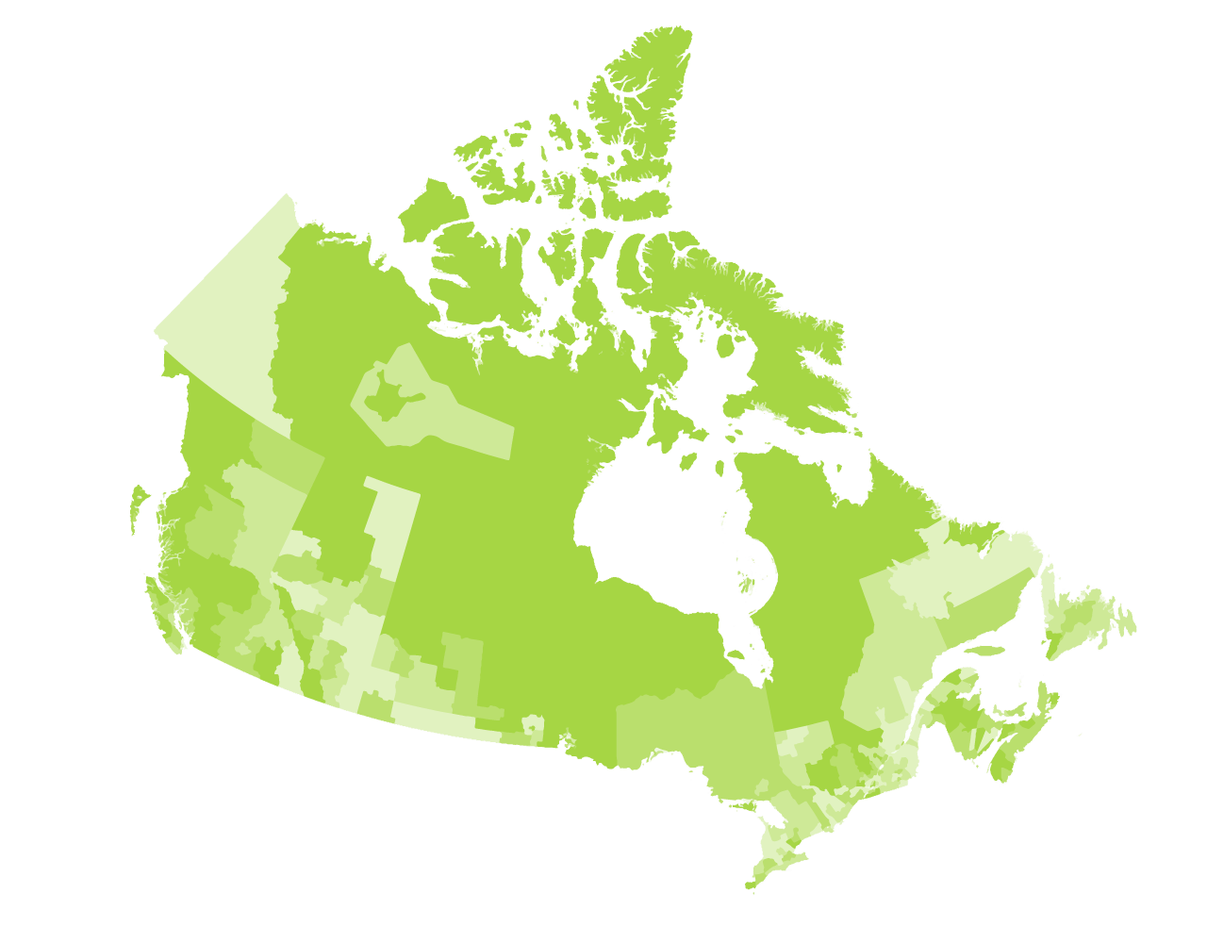

Longitudinal Immigration Database (IMDB)
CDP catalogue offerings
November 9^{h}, 2022

Slide 2
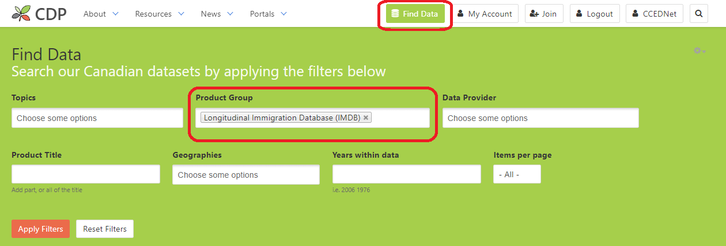
Where members can find IMDB products

Slide 3
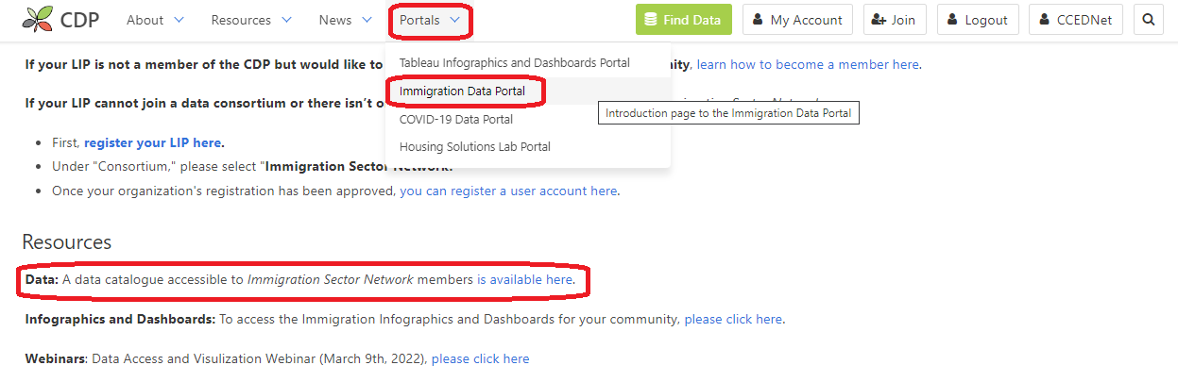
Where ISN members can find IMDB products
https://communitydata.ca/idp-data

Slide 4
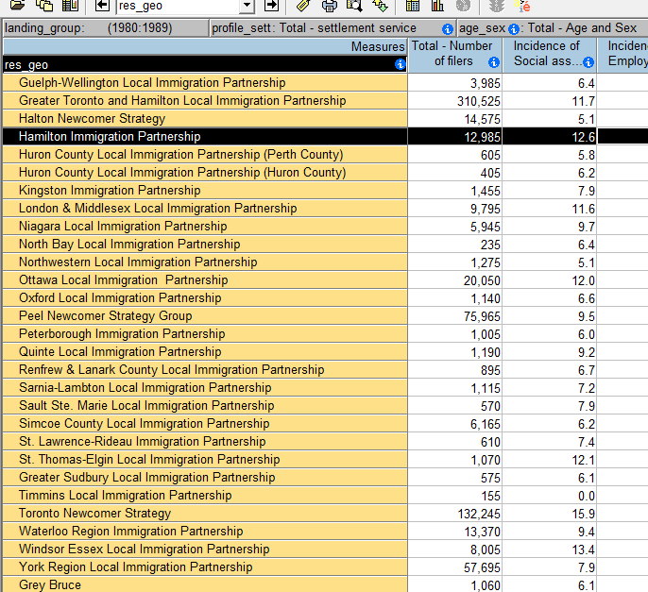
What IMDB products are available?
Four IMDB tables in the catalogue
  different geographic levels
  different tax years
Two sets of tables
  ‘core’ IMDB tables
  IMDB tables with ICARE* data (Settlement Services Data Module)
Each set contains a table on
  Economic outcomes
  Mobility
* ICARE = Immigration Contribution Agreement Reporting Environment

Slide 5

‘core’ IMDB tables dimensions
Admission Year
Tax Year
Age and Sex
Admission Category (family sponsored, economic, refugee)
Profile (Knowledge of Official Languages, World Area of Birth, Citizenship/pre-admission experience)
can cross-tabulate these dimensions with each other and with either:
Economic measures (incidence of social assistance, employment earnings, employment insurance, median income…)
OR
Mobility measures (in-migration, out-migration, retention rate…)

Slide 6
ICARE IMDB tables dimensions
Admission Year
Tax Year
Age and Sex
Admission Category and World Area of Birth
Settlement services received
can cross-tabulate these dimensions with each other and with either:
Economic measures (incidence of social assistance, employment earnings, employment insurance, median income…)
OR
Mobility measures (in-migration, out-migration, retention rate…)

Slide 7
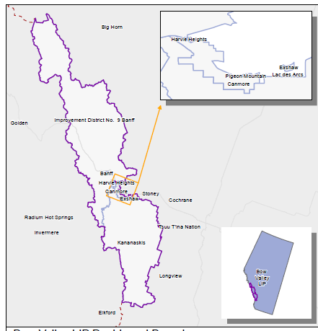
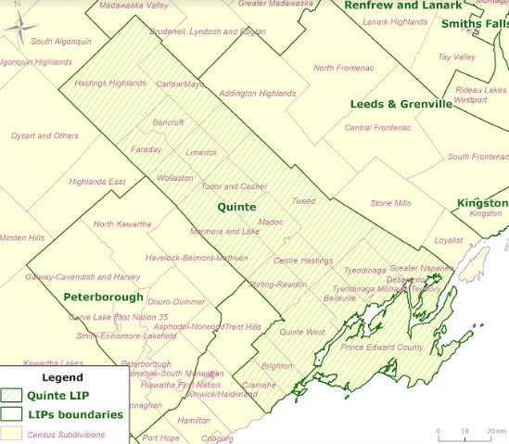
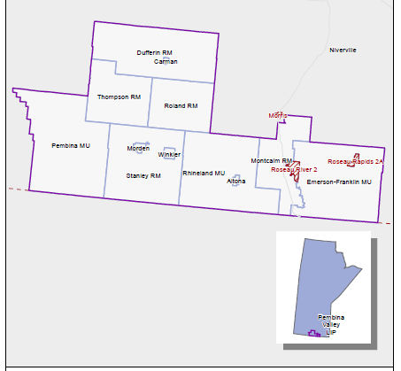
IMDB tables – Geography and Universe
Geography
  Census Divisions (CD)
  Census Subdivisions (CSD)
  LIP custom geographies
LIP custom geographies
  represent LIP service areas and study areas
  e.g., aggregations of Census Subdivisions
Universe
  Immigrant taxfilers aged 15+

Slide 8
Questions?
Get in touch!
information@communitydata.ca

