Slide 1
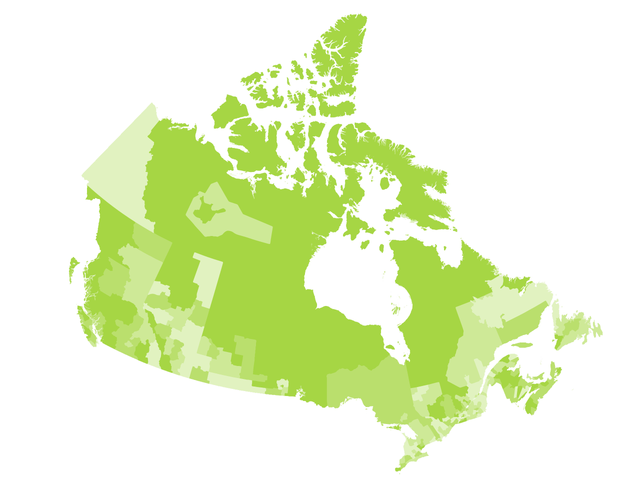


Community Data Program
Fall 2021 Leads Meeting
September 23rd 2021

Slide 2
Agenda
Welcome & Introductions
Data Acquired & New Data Products
Update re: Census 2021 &
Custom Geos
Solutions Lab
Partnerships
Update on Strategic Plan & Survey Launch
Renewal of Agreements
Upcoming Webinars
Next Steps
Notes:
Sasha

Slide 3
Welcome & Introductions
Notes:
All

Slide 4
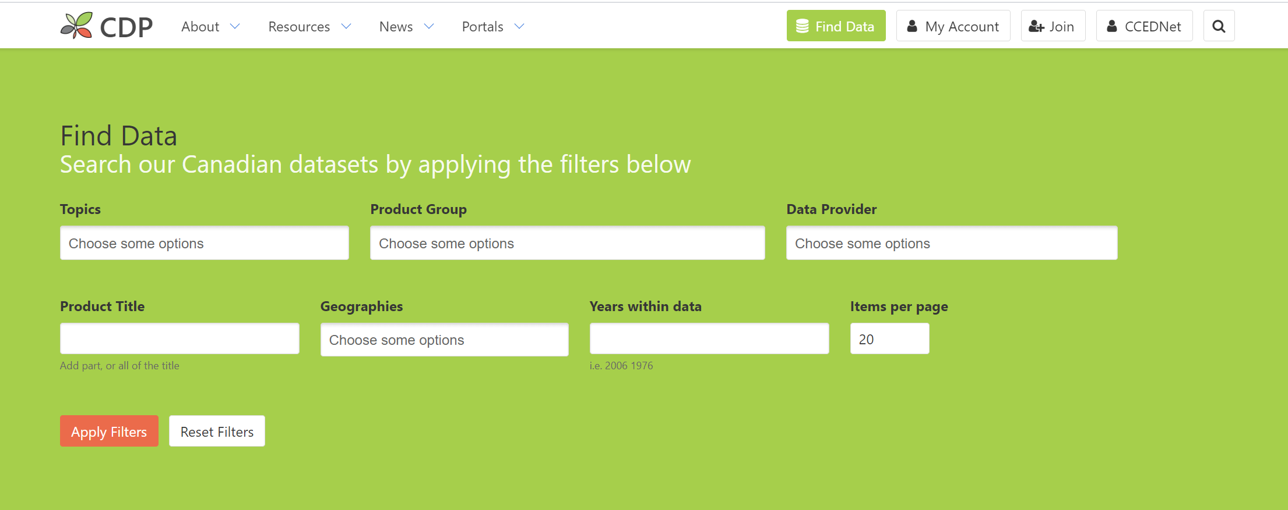
Data Acquired & New Data Products
All CDP data can be found in the CDP catalogue
62 new data products added to the CDP catalogue since April 1st, 2021
https://communitydata.ca/data
Notes:
Mike

Slide 5
Data Acquired & New Data Products
Highlights
CPP-9 (housing affordability, demographics, low income)
CPP-10 (depths of poverty, modest income)
HH-TGP (owner/renter, paying 30%+/50%+ on shelter)
Liquid assets for CSDs (data quality issues)
Canadian Index of Multiple Deprivation
Notes:
Mike

Slide 6
Data Acquired & New Data Products
Highlights
CERB statistics
T1FF tables (CSD now a standard geography)
Canadian Business Counts
Building Permits (more detailed data to come)
CMHC – Vacancy rates to be cataloged shortly
Notes:
Mike

Slide 7
Data Acquired & New Data Products
Dashboards and Infographics
Creating dashboards/ infographics as data access and visualization tools
Update on Community Recovery Dashboard
Suggestions for future dashboards welcome!
Technical support for Tableau Reader available
Notes:
Mike

Slide 8
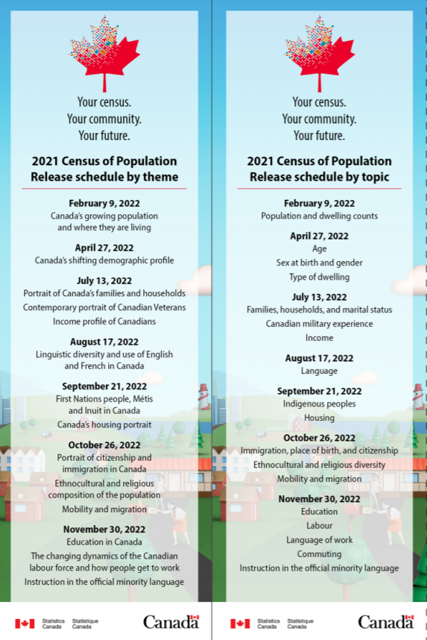
2021 Census
2021 Release Schedule
First release February 9th, 2022
Full release November 30th, 2022
Statistics Canada ready to receive custom orders by late 2021
Notes:
Mike

Slide 9
2021 Census
Custom Tables
Fully customized tables
Standard tables with customizations
Standard tables at community-level geographies
Prioritization exercise
Process involves Leads and DPAWG
Create priority "score" for data products
Score based on downloads and endorsements from Leads and DPAWG members
Notes:
Mike

Slide 10
2021 Census - Geographies
Tables at custom geographies
Priority tables to acquire at custom geographies determined via prioritization exercise
Geocoding process
Standard geographies release date: November 17th
Reminder: send in custom geography files & metadata
Notes:
Mike

Slide 11
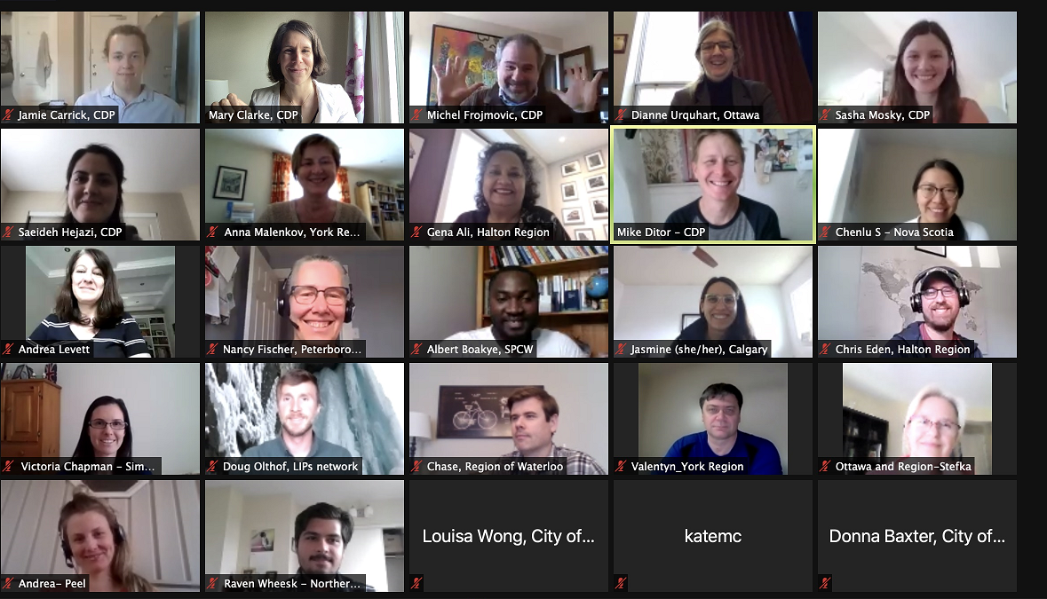
Actions Arising from Leads' meeting
GIS products
Housing stock data
Disaggregated equity data
Intercensal population estimates
Health data
Immigration data
Rural data
Labour Force data
Taxfiler data
Data visualization
Community Snapshots
Program administration
Notes:
Michel

Slide 12
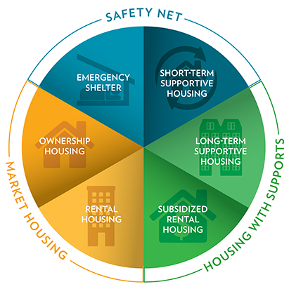
Solutions Lab
Prototype Development: Community Decision Support Tool for Housing Issues
Project Goal
Offer credible and accessible data sources for local housing practitioners located anywhere in Canada to serve as one input to strengthen evidence-based housing-related decisions.
Source: https://www.cmhc-schl.gc.ca/en/blog/2019-housing-observer/wheelhouse-new-way-looking-housing-needs
Notes:
Michel

Slide 13
Solutions Lab Project Timeline
2 Mar. 2021
National Insight Generation Workshop
22 Apr. 2021
National level ideation session followed by micro-labs engagement of local stakeholders ideation sessions
15 June 2021
National session to share ideas from local micro-labs & confirm prototyping approach
14 Sep. 2021
Prototyping activities workshop
9 Nov. 2021
Developmental Prototype: V.1 Suite of Tools
7 Dec. 2021
Developmental Prototype: V.2 Suite of Tools
8 Feb. 2022
Lessons Learned Roundtable / Road map engagement session
8 Mar. 2022
Sharing project results and transition to post-project implementation
Notes:
- Michel

Slide 14
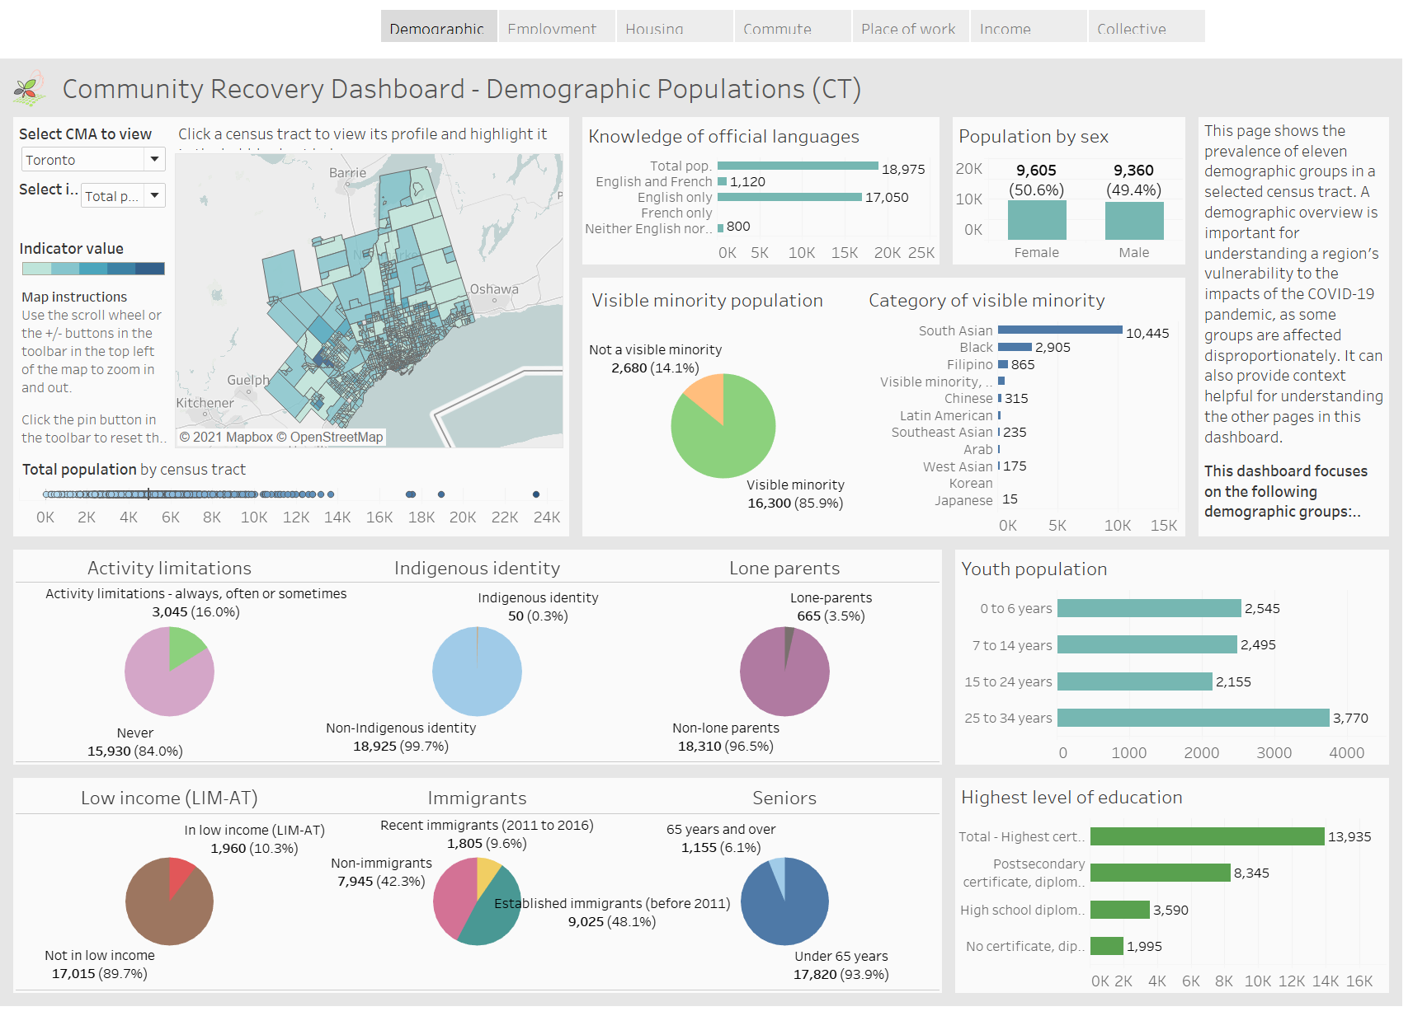
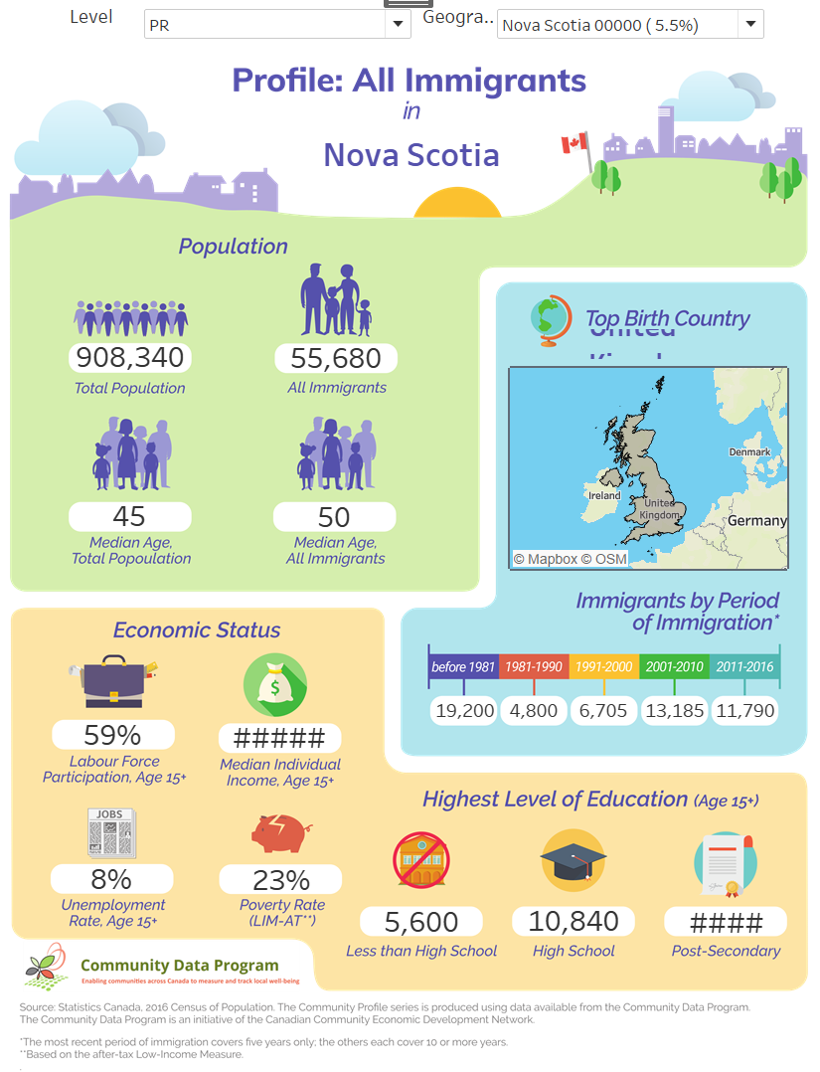
Solutions Lab Prototype
Dashboard-style for Analysts
Infographic-style Storyboard
Notes:
- Michel

Slide 15
Partnerships
Partnership with Local Immigration Partnerships National Secretariat (Jasper, AB)
Evolving relationship with Statistics Canada (from customer to partner)
Data swapping agreement with CMHC
Emerging partnership with Canadian Alliance to End Homelessness (CAEH)
Emerging partnership with Centre for Rural Economic Development (CENRED)
Notes:
Michel

Slide 16
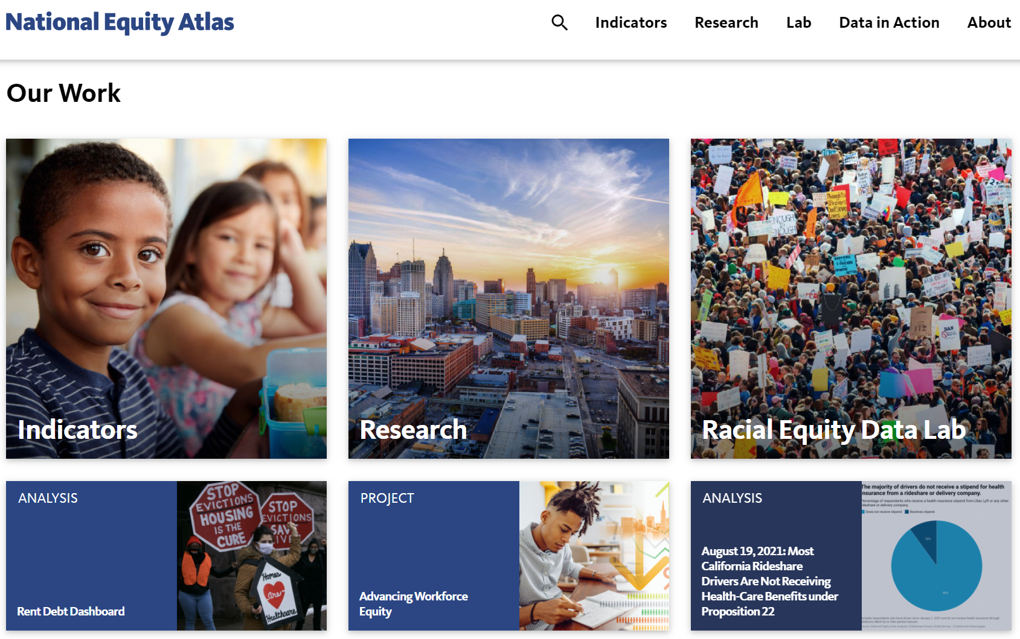
Partnerships: New possibilities
National Equity Atlas
Is there interest in creating the Canadian equivalent of the National Equity Atlas?
https://nationalequityatlas.org/
Notes:
Michel

Slide 17

Update on Strategic Plan & Survey Launch
Renewal of 5-year Strategic Plan
Launch of Member Survey – Today!
CDP Strategic Plan
2022-2027
Notes:
Saeideh

Slide 18
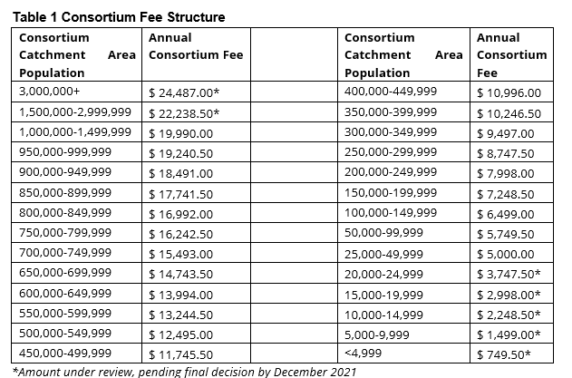
Renewal of Consortium Agreements
Renewal Package Includes:
Letter than can be adapted to justify renewal (for internal use)
Template agreement with CCEDNET – Signed by Lead
Overview of significant changes to agreement
First time leads to enter into direct agreement with CCDNET
Removal of sales tax
Changes to fee structure - top end cap moved to pop of 3 million up from 1 million; bottom end floor moved to pop of less than 25,000 from 50,000
By request:
Letter justifying using CCEDNet as sole source vendor
Notes:
Michel

Slide 19

Upcoming Fall Webinars
Statistic Canada's work towards linked databases using building footprints and property parcels
Presented by: Joseph Kuchar, Lead Analyst at the Linkable Open Data Environment Initiative, Statistics Canada
Date: 1:30 – 3:30 ET, September 28th, 2021
Register here
Orientation to the Community Data Program
Presented by: Community Data Program Team
Date: 1:30 – 3:30 ET, October 26th, 2021
Notes:
- Sasha

Slide 20
Next Steps
Data Purchase & Access Working Group – September 29th - Meet to advance census requests and custom geographies
Strategic Plan Survey – Please complete and distribute amongst consortium members
Lead’s Meeting – May 2022 (In-person location TBD *Covid-19 restrictions permitting*)
Notes:
- Sasha

Slide 21
Thank You!
Notes:
- Sasha

