Slide 1



Data Community Webinar
December 18, 2018
1

Slide 2
Outline
1
Background
2
Latest Results
3
Next Steps
2

Slide 3
Background

Slide 4
Questions on the Minds of Canadians
4
What is the mix of housing types across the country and how is this evolving?
How tight is housing land supply in urban cores?
How vulnerable are Canadians to interest rate changes or economic shocks?
?
?
?
How many millennials are in the housing market compared to other generational cohorts?
What’s the role of foreigners or non-residents in Canada’s residential markets?
What is the demographic profile of property owners?
?
?
?
?
What share of household income is used for mortgage payments? Based on property type, owner characteristics?
How many homes or apartments are not occupied? And where is this happening?
How extensive is house flipping (resale in less than one year)?
?
How much is speculation driving house price increases?
?
?
How affordable is home ownership across Canada?
How are house prices changing over time?
What is the average price of a single family home?
What kind of residential property do non-residents purchase and where?
?
?
?
?
?
How many Canadians own more than one property?
?
What can be bought for $200,000, $400,000 or $1,000,000 in my city?
4

Slide 5
Government of Canada is Committed to Addressing Gaps in Nationwide Housing Data
5
Budget 2016
Funds allocated to Statistics Canada to investigate and develop options related to “methods for gathering data on purchases of Canadian housing by foreign homebuyers”
Conclusion: Create a national property database which would consist of a listing of all properties within Canada
Budget 2017
“Budget 2017 also proposes to provide $39.9 million over five years, and $6.6 million per year thereafter, to Statistics Canada to develop and implement a new Housing Statistics Framework.”
Data on non-resident ownership in Vancouver and Toronto to be released at the end of 2017

Slide 6

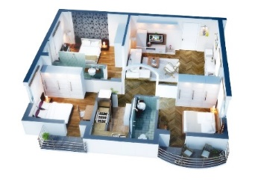

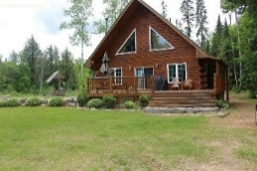


Content of Database
Address and Geography
Property Characteristics
Owner Characteristics
Property Use
Property Financing
Derived Indicators
Full address of the property:
Mailing
Legal
Civic
Geographic coordinates
(for internal use only)
Square footage
Structure Age
Lot size
Property type:
  Row housing
  Single-family home, etc.
Selling price
Transfer fees
Latest assessed value, Market value
# of rooms
Citizenship
Residency
Age
Gender
Marital Status
Income
Education
Household composition
Own account (owner occupation)
Investment (rental, capital gains)
Recreational
Social
Type of financing
Outstanding debt
Financing terms:
Amortization period
Interest rate
Value of mortgage debt
Affordability
Financial vulnerability or leverage
Housing availability
Market valuations
Characteristic distributions
Macro-prudential risk
Dependant on additional sources: energy efficiency, proximity measures, etc.
Only aggregated information will be published
6

Slide 7
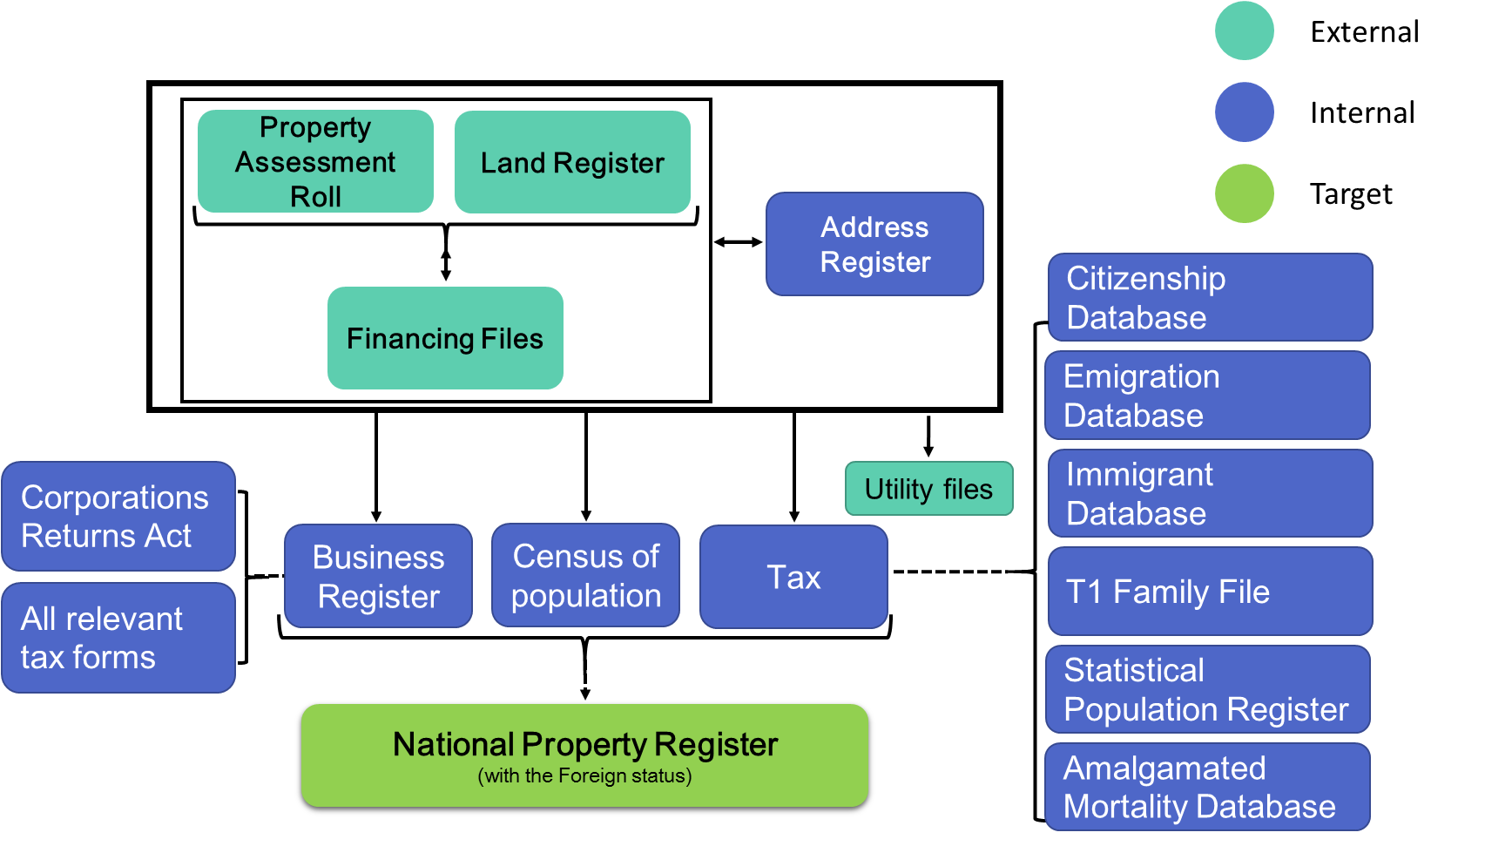
CHSP Framework

Slide 8
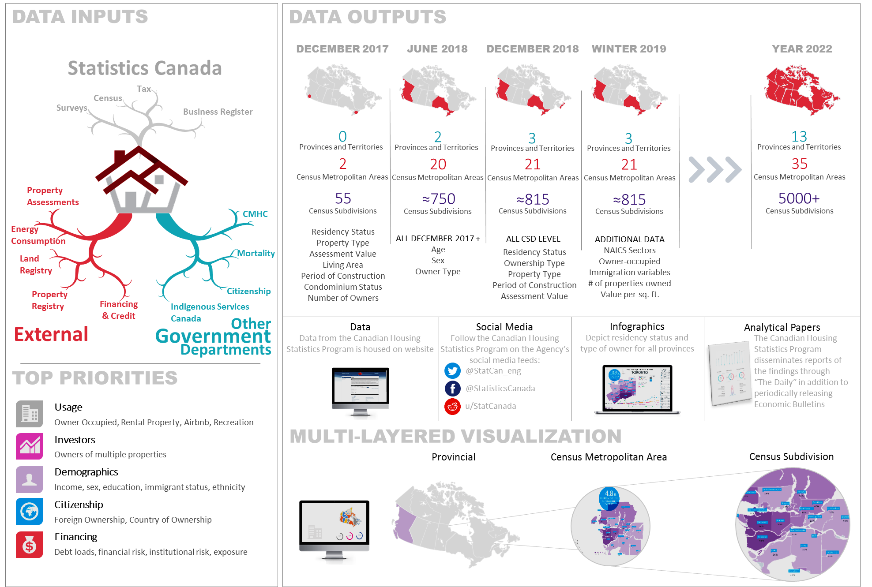
Program Overview

Slide 9
What has been released so far…
December 19, 2017
June 25, 2018
CMAs: Vancouver & Toronto
CSDs: 45
Indicators (7):
  Residency status
  Property type
  Assessment value
  Size of living area
  Period of construction
  Condominium status
  Number of owners per property
https://www150.statcan.gc.ca/n1/daily-quotidien/171219/dq171219b-eng.htm
CMAs: Ontario (16), BC (4)
CSDs: 749
Same indicators as December
PLUS
  Property-level data
    Owner type (individual/non-individual)
  Owner-level data
    Age
    Sex
  https://www150.statcan.gc.ca/n1/daily-quotidien/180625/dq180625a-eng.htm

Slide 10
CHSP’s Third Release
December 11, 2018
Geography: Nova Scotia (new jurisdiction)
  Nova Scotia (NS): 1 CMA (Halifax) and ~ 70 CSDs
  Ontario (ON): 16 CMAs and ~ 430 CSDs
  British Columbia (BC): 4 CMAs and ~ 315 CSDs
New vintage representing annual municipal tax roll for 2018
  Stock: NS - December 2017; ON and BC - January 2018
  Assessment Value: NS - January 2017; ON - January 2016 ; BC - July 2017
Property level data with owner-derived variables
  Table for Residency status (resident, non-resident of Canada)
  Table for Ownership type (individual, non-individual)
  Dimensions: geography (Prov, CMA, CSD), property type, period of construction
  Measures: number, percentage, average and median assessment value
https://www150.statcan.gc.ca/n1/daily-quotidien/181211/dq181211b-eng.htm

Slide 11
Latest Results

Slide 12
Key Findings
Non-resident ownership varies based on geography, type of property and age of construction
Non-residents own condos, more recent and more expensive properties in Vancouver and Toronto but not necessarily in Halifax
Non-resident ownership more prevalent outside large urban centres
Non-individuals (e.g. businesses, governments, non-profit) own less than 1 in 10 residential properties in Nova Scotia, Ontario and B.C., between 43.2% and half of it is vacant land

Slide 13
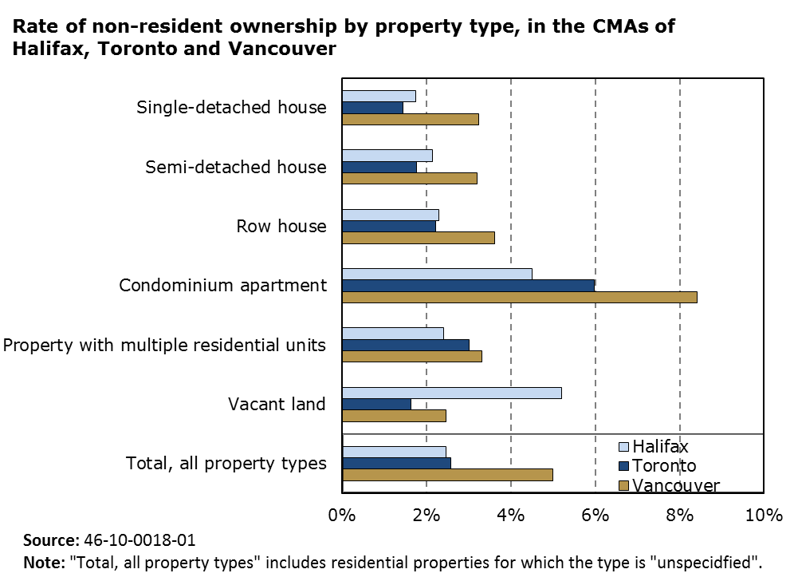
Non-resident ownership rate is lower in Halifax

Slide 14
Non-residents own more expensive properties in Vancouver and Toronto with some exceptions

Slide 15
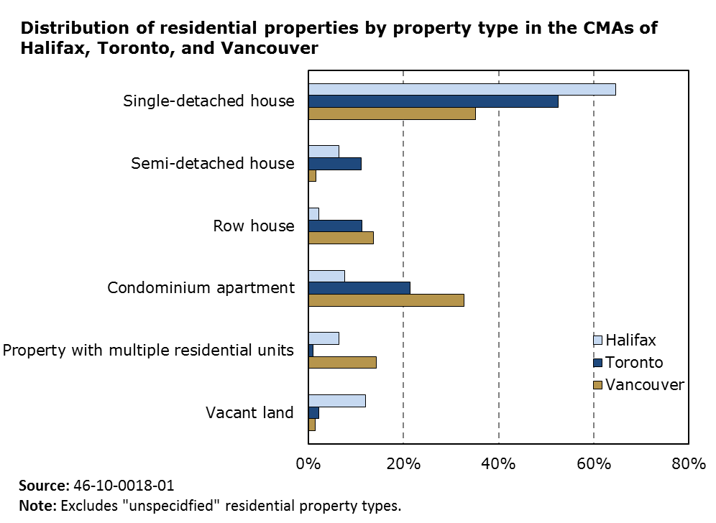
Condominium apartments less common and vacant land more common in Halifax CMA

Slide 16
Non-resident ownership more prevalent in recreational destinations
Nearly one in four Nova Scotian properties owned by non-residents is located on Cape Breton Island.
  Non-resident ownership rate: 5.6%
  Average value of single-detached houses higher for non-residents than residents (e.g. $175K vs $128K in Richmond Subd. A; $153K vs $135K in Victoria Subd. B)
Lunenburg, a UNESCO World Heritage Site along Nova Scotia’s south shore, has a non-resident ownership rate of 6.2%
Similarly, non-resident ownership rate is 15.9% in Whistler, BC, 9.7% in Rideau Lakes and 5.6% in Muskoka.

Slide 17
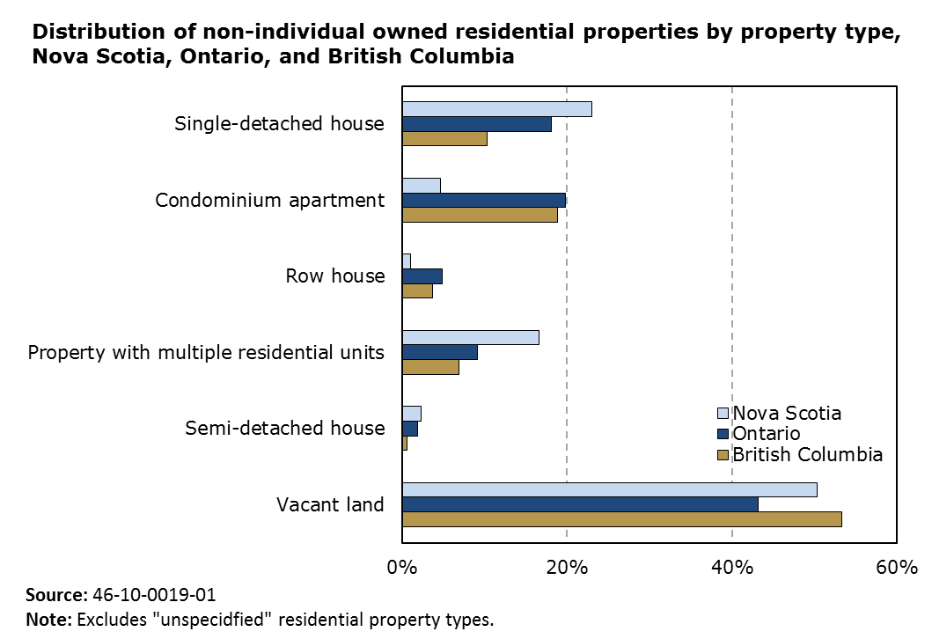
Non-Individuals own less than 1 in 10 residential properties

Slide 18
Next Steps

Slide 19
In depth articles, Winter 2019
Economic Insights
  Immigrants ownership
  Ownership of multiple residential properties
CMHC Articles - thematic approach by jurisdiction
  Non-individuals owners profile
  Mixed ownership – resident and non-resident
  Evolution of living area by period of construction
  Ownership by individual investors
  Non-resident ownership outside Vancouver and Toronto
  Study on residential vacant land

Slide 20
Plan for 2019 and beyond
Dissemination
Development &
Production
Expand geographic coverage
  New Brunswick
  Yukon
Expand variables published
  Adjusted Assessment value (with the same reference date)
  Property use (owner accommodation, investment and recreational)
  Citizenship
  Income
  Affordability
  Mortgage financing
Improve accessibility
  Data visualization tool
  Research Data Centres
  Virtual desktop infrastructure (VDI) technology
  Real Time Remote Access (RTRA)
  Development of a Housing Statistics Hub
Develop a quality framework
Onboard other jurisdictions
Adjust analysis and dissemination plan to make it more flexible
Increase partnerships with users to share expertise and capacity

Slide 21
Issues and challenges
Reliance on external data providers to acquire administrative files
Controlling scope
Meeting users’ expectations
Dissemination plan/schedule impacted by last-minute changes to analysis and priorities
Public perception of the use of administrative data
Ability to obtain sufficient IT infrastructure
Limited geographic detail due to limits by data providers
Ensuring a common definition of variables across jurisdictions

Slide 22
Follow-up Questions
How can Statistics Canada improve access to CHSP data?
What are the priority housing data gaps that should be addressing through this program?
How can we work together to achieve priority needs related to Housing data, research and analysis?

Slide 23



THANK YOU!
For more information,
please visit
www.statcan.gc.ca
#StatCan100
23

