Slide 1
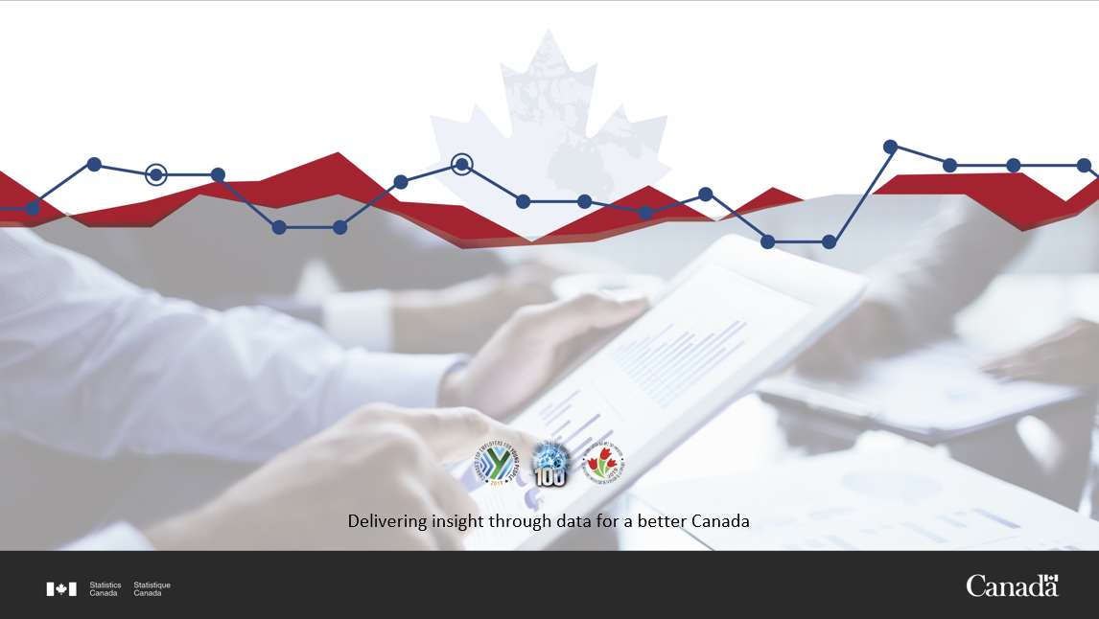
The Linkable Open Data Environment
Harmonizing Open Micro Data for Seamless Use
Joseph Kuchar, Robert Oikle
Data Exploration and Integration Lab (DEIL) · Centre for Special Business Projects (CSBP)
Community Data Program
Sept. 28th, 2021

Slide 2
Context: The Microdata Demand
Statistics Canada is a regular producer of (mostly aggregate) open data
There is an increased demand for more granular data
There is a wealth of open microdata available from many cities and provinces across Canada, on a variety of themes
Some of this data is complementary to Statistics Canada’s internal data holdings, while some can be (and has been) used to fill existing data gaps
Notes:
For example, until recently Statistics Canada had no internal listing of all hospitals in Canada, but this was available from open data portals and public web pages and used to fill data gaps. On the other hand, open data on businesses can be compared to our internal data holdings.

Slide 3
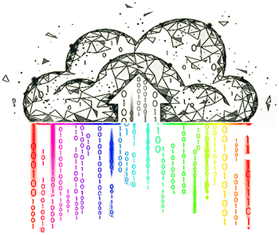
Linkable Open Data Environment (LODE)
Open micro databases released under the Canada Open Government License
Open tools
Collaboration
Interactive web map: LODE Viewer

Slide 4
Healthcare Facilities
ODHF
ODCAF
Cultural & Art Facilities
Educational
Facilities
ODEF
ODB
Buildings
Businesses
ODA
Addresses
Recreational & Sport Facilities
ODRSF
Infrastructure
Notes:
The central element can be thought of as the linkable environment in the Linkable Open Data Environment, and would allow for the linkages between databases. This is still in development, but you can imagine an API or webpage for linking together the different data sets. For example, linking addresses, healthcare facilities, and buildings would allow the user to identify buildings that are hospitals.

Slide 5

Building Footprints
Open Database of Buildings (ODB) version 2 released March 2019
  65 government open datasets into 1 database of 4.4 million records of building footprints
  Latitude, longitude, area, perimeter, Census subdivision (CSD)
https://www.statcan.gc.ca/eng/lode/databases/odb
Notes:
A compilation of 65 datasets originating from various government sources of open data (provincial, municipal)
4.4 million records of building footprints and variables calculated and standardized across all data providers
Harmonised and standardised dataset made available under the Open Government License - Canada

Slide 6
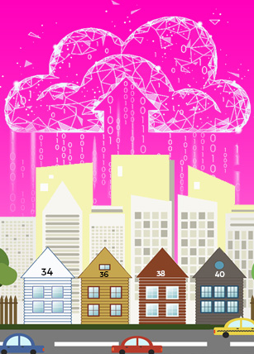
Addresses
Open Database of Addresses (ODA) version 1 released April 2021
  99 government open datasets into 1 dataset of ~10 million addresses
  Street direction, type, name
  Unit, postal code, city, CSD
https://www.statcan.gc.ca/eng/lode/databases/oda

Slide 7
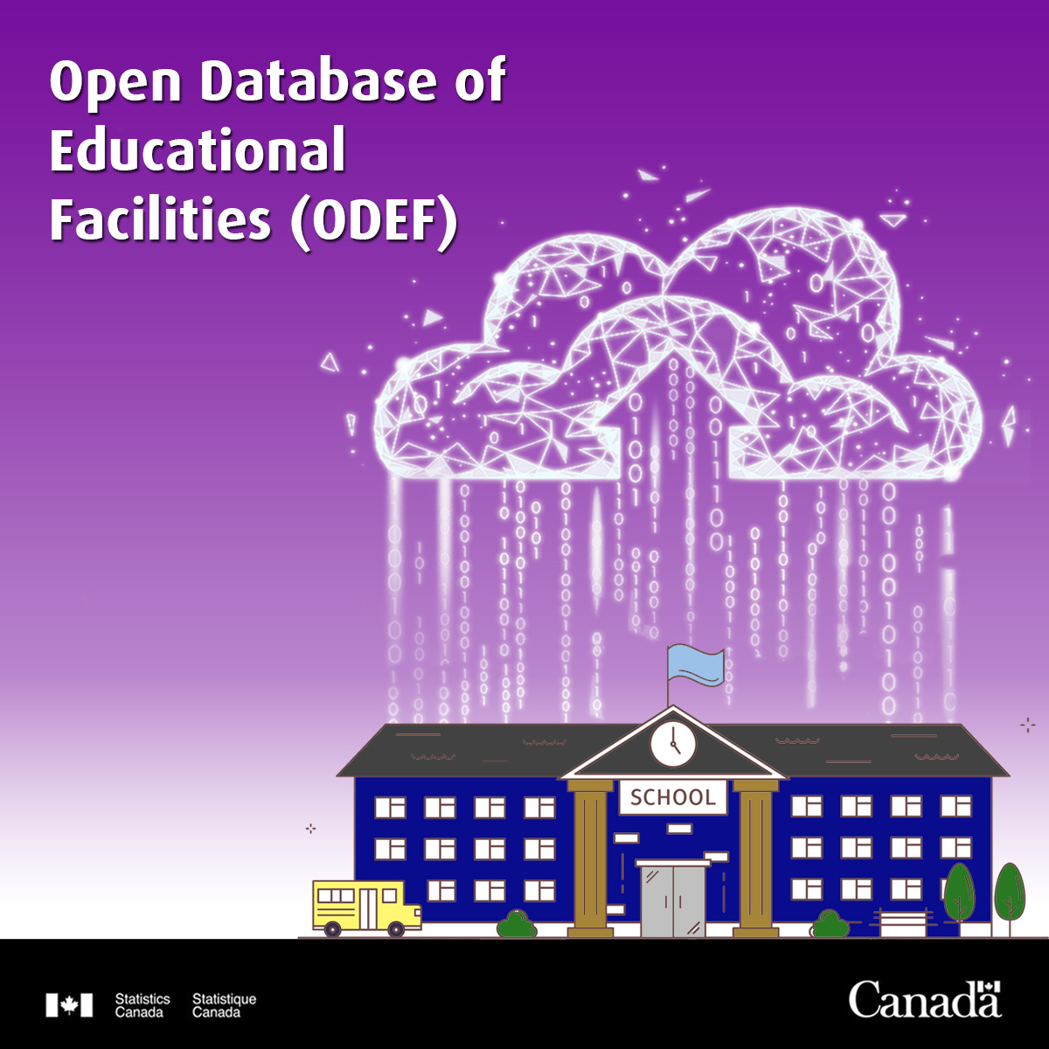
Educational Facilities
Open Database of Educational Facilities (ODEF) version 2 released April 2021
  Funded by CIRNAC
  Open data and publicly available data led to 19,000+ facilities
  Name, address, ISCED classification, latitude, longitude
https://www.statcan.gc.ca/eng/lode/databases/odef
Notes:
The educational facilities database is standardised with the International Standard Classification of Education (ISCED) levels, which are used to map different definitions of school levels (elementary, secondary, etc) to a standard definition across Canada.

Slide 8

Health Care Facilities
Open Database of Health Care Facilities (ODHF) version 1.1 released April 2020
  Government sources and CIHI data led to 7,000+ facilities
  Name, type (ambulatory care services, hospitals, nursing and residential care), address, latitude, longitude, CSD
https://www.statcan.gc.ca/eng/lode/databases/odhf
Notes:
In addition to provincial and municipal sources, data was provided by the Canadian Institute of Health Information (CIHI) and the Public Health Agency of Canada

Slide 9
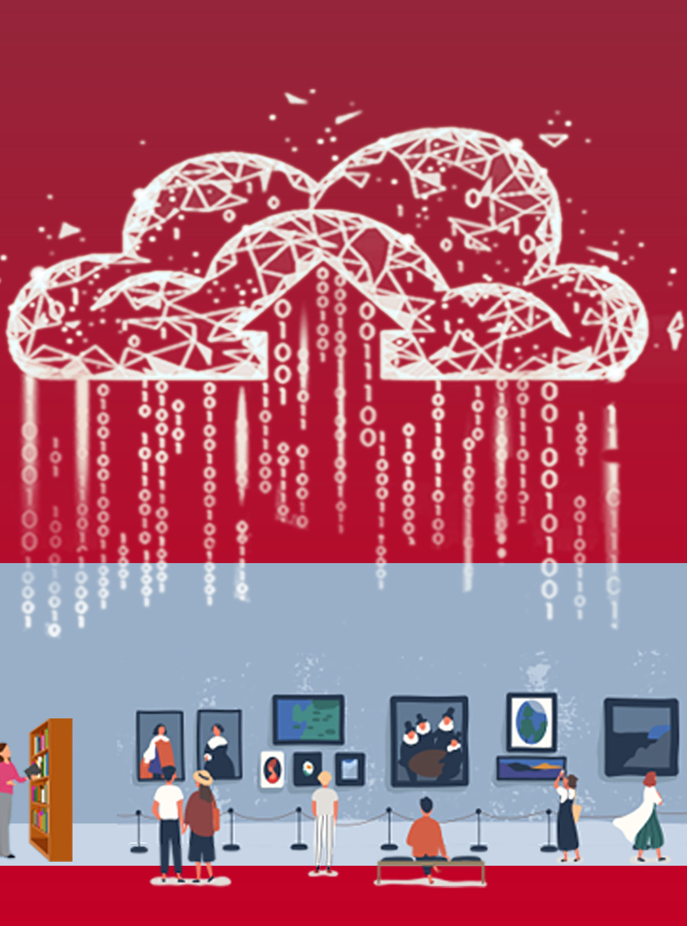
Cultural and Art Facilities
Open Database of Cultural and Art Facilities (ODCAF) version 1 released October 2020
  170 Government sources to 7,000+ museums, galleries, libraries and more
  Name, Type, Address, Latitude, Longitude, CSD
https://www.statcan.gc.ca/eng/lode/databases/odcaf
Notes:
In addition to provincial and municipal sources, data was provided by the Canadian Institute of Health Information (CIHI) and the Public Health Agency of Canada

Slide 10
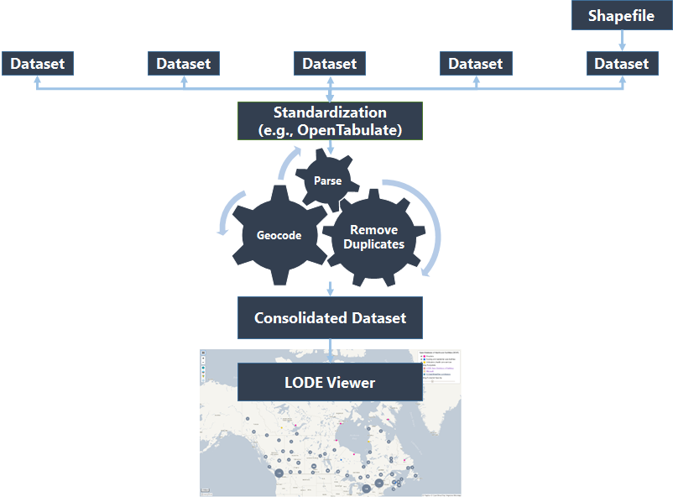
Process
1
2
3
4
5
Identify Data Sources
Access
Process & Standardize
Validate
Final Open Database
Federal, Provincial, Territorial, Municipal, Non-Profit
Application Programming Interfaces (APIs), Download, Scrape
Parse, Deduplication, Geocode
Duplication? Spelling errors?
ODEF, ODB, ODCAF, ODHF for download and on the LODE Viewer

Slide 11
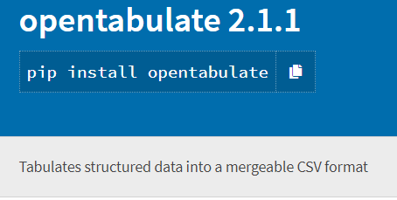
OpenTabulate
Python package developed in-house for standardizing data sets
Available on the Python package index
Uses JSON configuration files
Inspired by the work of OpenAddresses

Slide 12
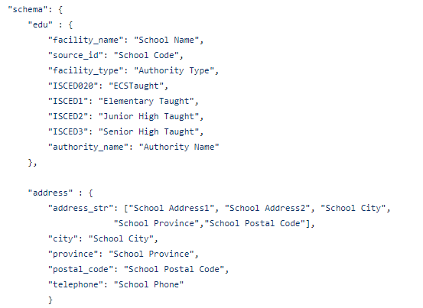
OpenTabulate example - ODEF
The JSON shown on the left describes the mapping to convert downloaded Alberta school data to the standard columns used in the ODEF.
Multiple fields are concatenated to create a single address field.

Slide 13
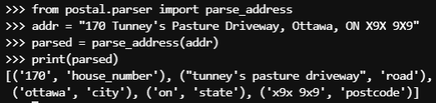
Address parsing
The popular LibPostal (https://github.com/openvenues/libpostal) library is used to parse addresses into components.
Separating addresses into components makes it easier to record link and identify potential duplicates.

Slide 14
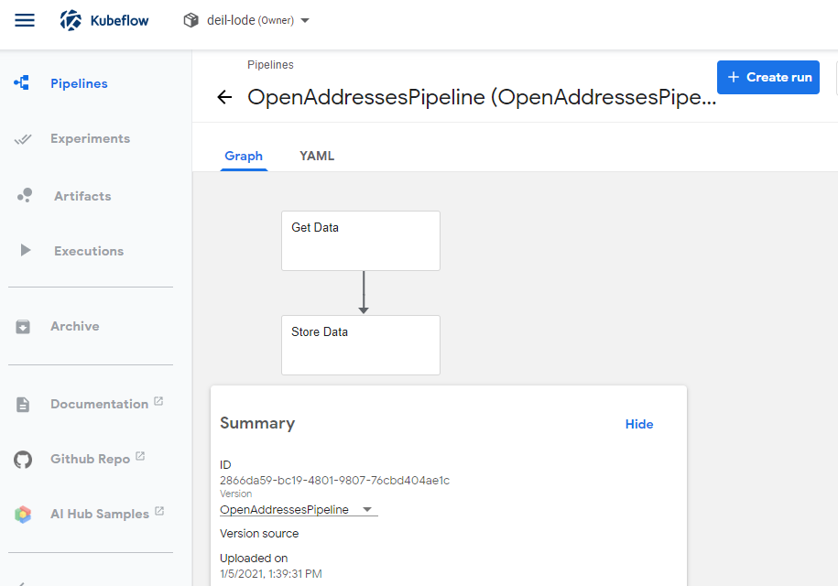
ODA Collection
Initial collection and processing was done with a modified version of the processing pipeline developed by OpenAddresses (https://github.com/openaddresses/openaddresses)
Automated collection of multiple types of data sources (CSV, shapefile, geoJSON, and ESRI REST API)
Uses a similar JSON data dictionary method as OpenTabulate
Implemented in the cloud on the Advanced Analytics Workspace in the form of a Kubeflow Pipeline

Slide 15
ODA Standardization
Collected address data comes in a range of detail, from single line (e.g., “10 main street”) to already parsed and standardized (e.g., “10”, “MAIN”, “ST”)
To standardise address components, a modified version of the Road Attribute Search Key (RASK) Python implementation was used to separate out street types and directions.

Slide 16
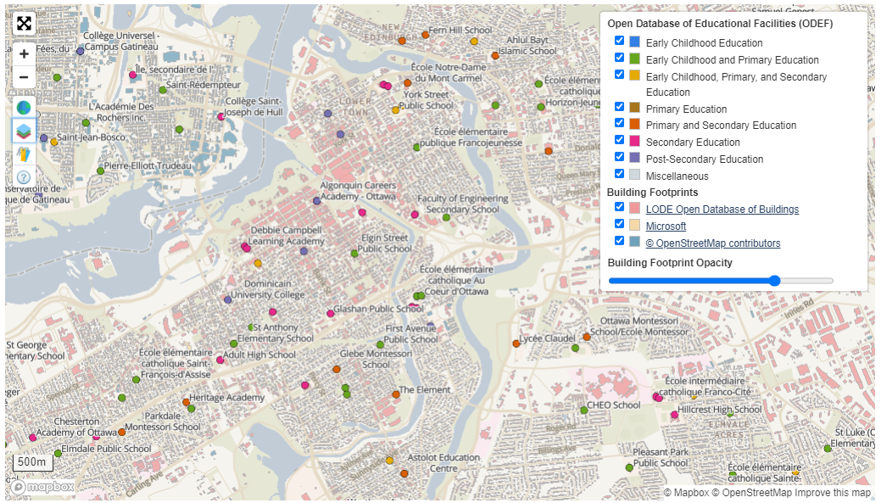
LODE Viewer
Interactive webmap to visualize LODE datasets
Includes layer of building footprints that combines the Open Database of Buildings, OpenStreetMap, and Microsoft's Canadian Building Footprints.
https://www150.statcan.gc.ca/n1/pub/71-607-x/71-607-x2020014-eng.htm

Slide 17
LODE Viewer
Interactive web map using Open Source Mapbox technology
Provides a customizable interface for exploring data
Data consists of the LODE georeferenced databases released
https://www150.statcan.gc.ca/n1/pub/71-607-x/71-607-x2020014-eng.htm

Slide 18
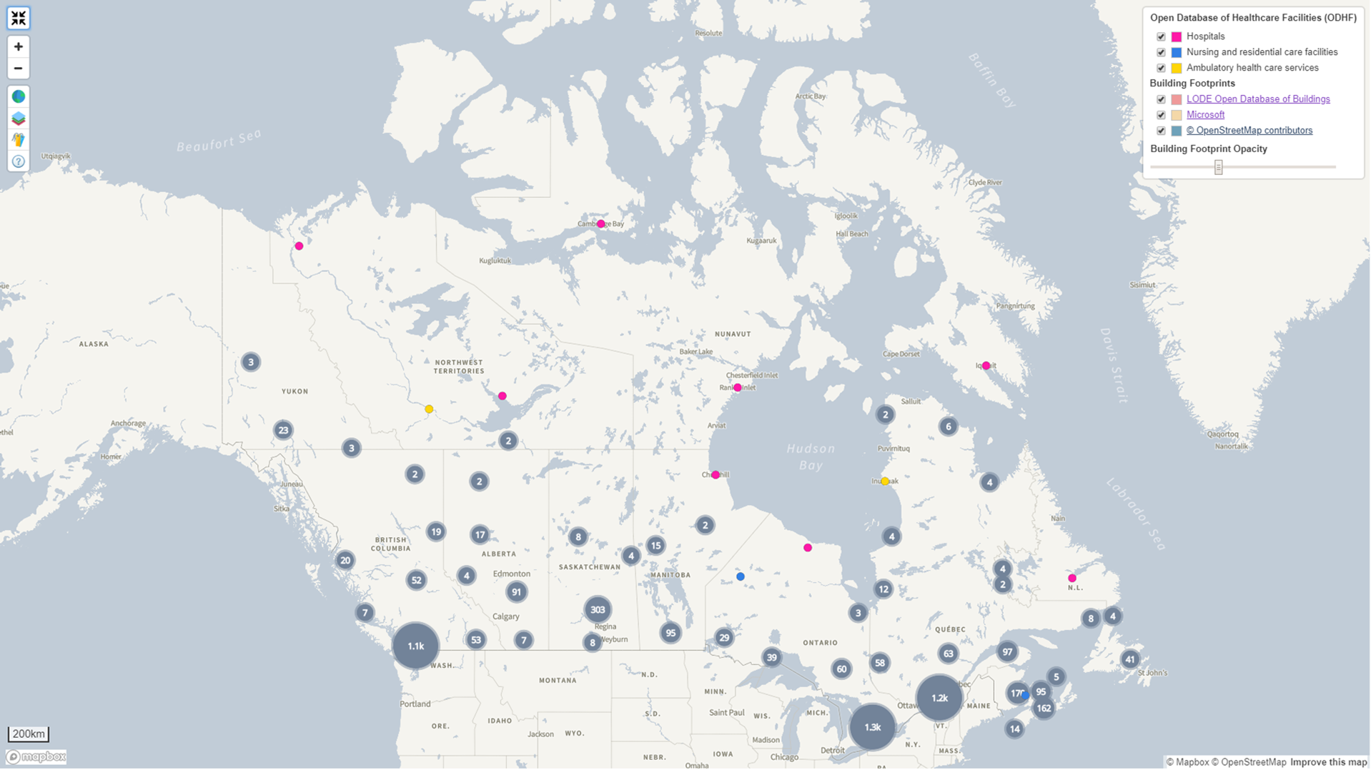
LODE Viewer
1
2
3
Compress Open Database
Upload to Mapbox Studio
Update Configuration Files
CSVs or Shapefiles to tilesets
Style basemaps
Add title, add map layer

Slide 19
Expanding ODB & ODEF in the LODE Viewer
Merging and processing of over 13 million building footprints
LODE Open Database of Buildings V2 (ODB) - https://www.statcan.gc.ca/eng/lode/databases/odb
OpenStreetMap (OSM) - https://www.geofabrik.de/
Microsoft Canadian Building Footprints (MS) -https://github.com/microsoft/CanadianBuildingFootprints

Slide 20

Open Tools
OpenTabulate
Python package for data processing
ICBF
Integrated Canadian Building Footprints
COAP
Canadian Open Address Processing
Web Mapping
Web mapping components
Data linkage (coming soon)
Notes:
The central element can be thought of as the linkable environment in the Linkable Open Data Environment, and would allow for the linkages between databases. This is still in development, but you can imagine an API or webpage for linking together the different data sets. For example, linking addresses, healthcare facilities, and buildings would allow the user to identify buildings that are hospitals.

Slide 21
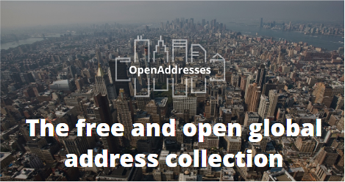
Collaborations & Data Partners
Students from UBC and Fleming College analyzed the ODB and ODHF for academic capstone projects
Microsoft created an openly licensed dataset of 11.8 M building footprints across Canada using the ODB as a training dataset
OpenAddresses is a non-profit that has compiled address point data around the world
AccessNow is a start-up collecting and mapping physical accessibility data
Notes:
Our open databases are only as good as the data released by data providers such as municipalities and provinces
We are interested in soliciting feedback from original data owners and move towards common standards
Students from UBC and Fleming College analyzed the ODB and ODHF for academic capstone projects
Microsoft created an openly licensed dataset of 11.8 M building footprints across Canada using the ODB as a training dataset
OpenAddresses is a non-profit that has compiled address point data around the world
Taking advantage of their work gives us a boost both in terms of identifying sources, but also in terms of using their processing pipeline

Slide 22
Future Plans
Integration into a database environment for better web services (e.g., API)
Open Databases of Businesses and Infrastructure are major projects for this year. Any dataset recommendations?
More database ideas! Have any to share?

Slide 23
THANK YOU!
For more information,
alessandro.alasia@canada.ca
joseph.kuchar@canada.ca
MERCI!
Pour de plus amples renseignements,
alessandro.alasia@canada.ca
joseph.kuchar@canada.ca
#StatCan100

Slide 24
Resources
LODE: https://www.statcan.gc.ca/eng/lode
LODE Viewer: https://www150.statcan.gc.ca/n1/pub/71-607-x/71-607-x2020014-eng.htm
LODE Viewer GitHub repo: https://github.com/CSBP-CPSE/lode-viewer
COAP: https://github.com/CSBP-CPSE/Canadian-Open-Address-Point-Processing
ICBF: https://github.com/CSBP-CPSE/ICBF-EIIC
OpenTabulate: https://github.com/CSBP-CPSE/OpenTabulate

