Slide 1


Mapping Indicators of Canadian Urban Sustainability:
A Neighbourhood Energy Poverty Measurement Framework
Canadian Urban Sustainability Practitioners Network (CUSP)

Slide 2
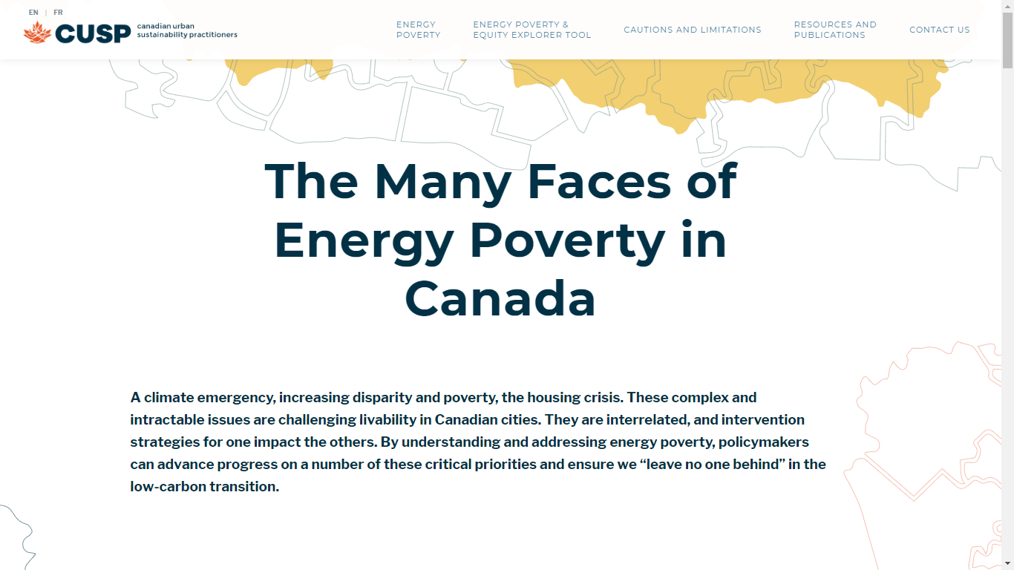

Slide 3
Project Background
CUSP to support Energy Poverty Reduction Through Clean Energy Transformation by means of Local Energy Access Programs (LEAPs)
LEAPs will:
  help achieve energy and emissions goals
  bring technologies to help transition to clean energy
  increase capacity to implement energy access programs
  ensure low/moderate income households benefit from decreased energy poverty
CUSP and local Clean Energy Access Coalitions to model outcomes of clean energy transitions

Slide 4
Project Objectives
Data access tool built by the Community Data Program Analytics Service
Centre equity in design of clean energy programs
Monitor and report on indicators of home energy cost burden
Cross-tabulate with indicators of household equity and housing characteristics
Support better outcomes for low and moderate income households and other historically underserved groups

Slide 5

Measurement Framework Overview
All data from 2016 Census
Household energy expenditures:
  electricity, oil, gas, coal, wood, other fuels
Household, housing and demographic characteristics
Data available for:
  Provinces
  Census Divisions
  Census Subdivisions
  Census Metropolitan Areas
  Census Agglomerations
  Census Tracts

Slide 6
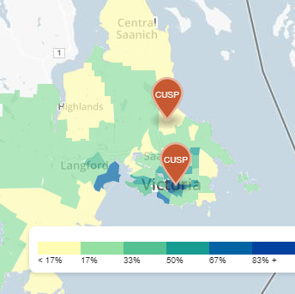
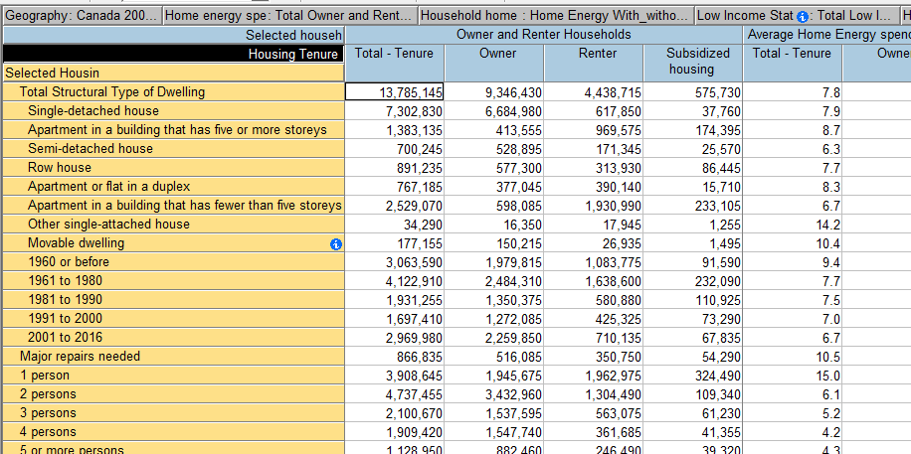
Measurement Framework Overview
Two main purposes
  Mapping tool
    Neighbourhood energy poverty profiles for urban regions
    Community energy profiles for rural communities
    Can cross-tabulate against high home energy cost burden - e.g., low-income households spending more than 6% of after-tax income on home energy
  In-depth analysis
    Multi-dimensional table
    Input for municipal policy and program design

Slide 7
A Rich Data Set to Support Policy and Program Design
Dimensions that can be cross-tabulated – Households Universe
Home energy spending as % after-tax household income (6)
Household home energy expenditures (3)
Low Income Status (LIM-AT) (2)
Household after-tax income groups (6)
Housing Tenure (4)
Selected housing characteristics (22)
Selected Household Statistics (8)

Slide 8
Multi-dimensional table specifications
Households with at least one person aged 65+
Households with at least one person aged 18+ who speaks neither English nor French as the language spoken at home
Households with at least one person aged 18+ who is a recent immigrant (2011 to 2016)
Households with at least one person aged 18+ who is a visible minority
Households with at least one person aged 18+ who is Aboriginal identity
Households with at least one person aged 25+ without certificate, diploma or degree
Households where no person aged 18+ has full-time/full-year employment
Households by Census family structure (couple family, lone-parent, non-Census family…)
CAN NOT BE CROSSED WITH HOUSEHOLD AFTER-TAX INCOME GROUPS
Notes:
Can talk about the equity aspect of the data here.

Slide 9
Household transportation energy costs - Data Gap
Develop an indicator of the percentage of household income spent on transportation costs at the census subdivision (municipal) and census tract (neighbourhoods) across Canada.
The indicator should permit comparability across geographies and over time.
PROXY
Households by commuting mode and distance travelled in car (COMING SOON)
Notes:
Can talk about the equity aspect of the data here.

Slide 10
A few results…

Slide 11

Households with high energy cost burden (>6%)

Slide 12
Households with high energy cost burden (>6%)
CUSP members

Slide 13
Median home energy expenditure by tenure
CUSP members

Slide 14
Households in Canada paying at least 6% of after-tax income, by income bands

Slide 15
Households in Canada paying at least 6% of after-tax income, by low income status (LIM-AT)

Slide 16
Households in Canada paying at least 6% of after-tax income, by tenure

Slide 17
Renter households in CUSP cities paying at least 6% of after-tax income

Slide 18
Renter households in CUSP cities with home energy expenditures

Slide 19
Households in Canada paying at least 6% of after-tax income, by structural type

Slide 20
Households in Canada paying at least 6% of after-tax income, by period of construction

Slide 21
Households in Canada paying at least 6% of after-tax income, by CMA/non-CMA status

Slide 22
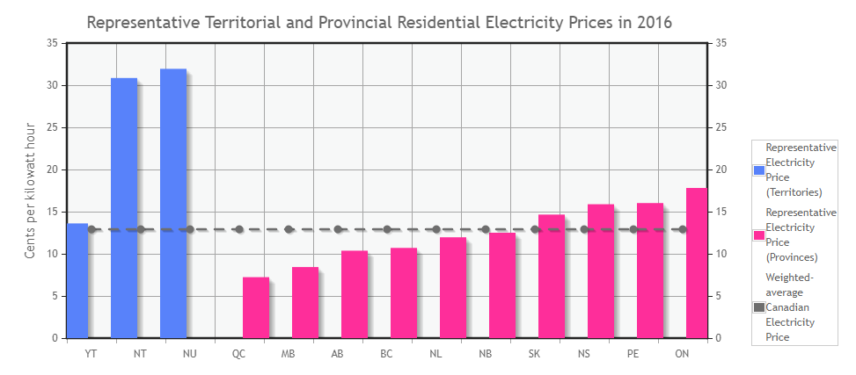
Source: Canada Energy Regulator, 2017
https://www.cer-rec.gc.ca/nrg/ntgrtd/mrkt/snpsht/2017/02-03hghcstpwr-eng.html

Slide 23
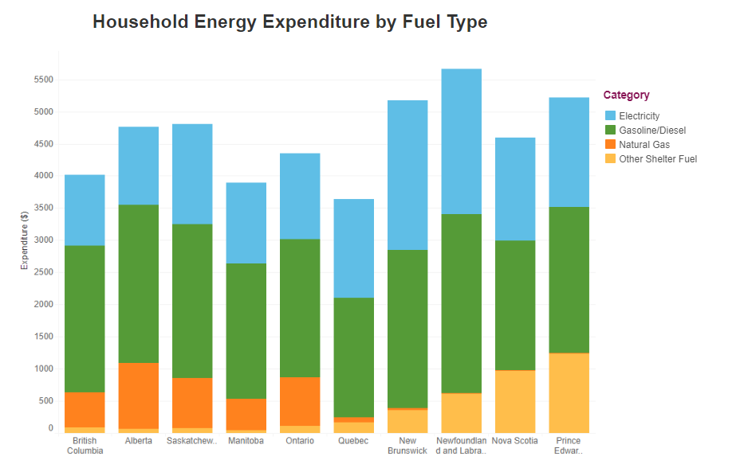
Source: Canada Energy Regulator, 2017
http://www.cer-rec.gc.ca/nrg/ntgrtd/mrkt/snpsht/2019/08-03hshldxpndtrs-eng.html

Slide 24
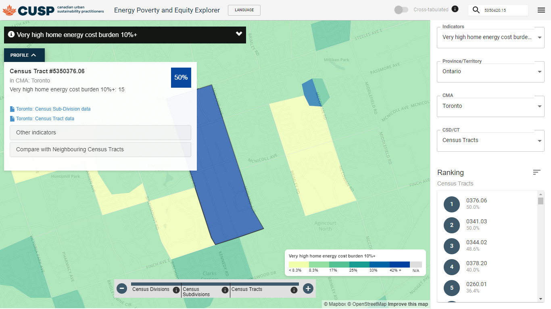
A tour of the Energy Poverty and Equity Explorer…
http://cusp-mapping.herokuapp.com/

